Slide 1
CMSC204
Kartchner
V(StateGraph) = {Oregon, Alaska, Texas, Hawaii, Vermont, NewYork, California}
E(StateGraph) = {(Alaska, Oregon), (Hawaii, Alaska), (Hawaii, Texas), (Texas, Hawaii), (Hawaii, California), (Hawaii, New York), (Texas, Vermont), (Vermont, California), (Vermont, Alaska)}
1. Draw the StateGraph
Oregon
Alaska
Texas
Hawaii
Vermont
New York
California

Slide 2
a. Show the adjacency matrix that would describe the edges in the graph. Store the vertices in alphabetical order
States
Alaska California Hawaii New York Oregon Texas Vermont
Alaska
0 | 0 | 0 | 0 | 1 | 0 | 0
0 | 0 | 0 | 0 | 0 | 0 | 0
1 | 1 | 0 | 1 | 0 | 1 | 0
0 | 0 | 0 | 0 | 0 | 0 | 0
0 | 0 | 0 | 0 | 0 | 0 | 0
0 | 0 | 1 | 0 | 0 | 0 | 1
1 | 1 | 0 | 0 | 0 | 0 | 0
California
Hawaii
New York
Oregon
Texas
Vermont
3. b. Show the adjacency lists
that would describe the edges in the graph
Alaska: {Oregon}
California: {}
Hawaii: {Alaska, Texas, California, New York}
New York: {}
Oregon: {}
Texas: {Hawaii, Vermont} Vermont: {California, Alaska}

Slide 3
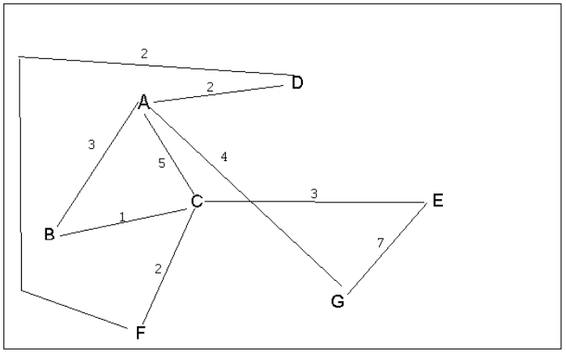
4 a. Which of the following lists the graph nodes in depth first order beginning with E?
A) E, G, F, C, D, B, A
B) G, A, E, C, B, F, D
C) E, G, A, D, F, C, B
D) E, C, F, B, A, D, G
4 b. Which of the following lists the graph nodes in breadth first order beginning at F?
A) F, C, D, A, B, E, G
B) F, D, C, A, B, C, G
C) F, C, D, B, G, A, E
D) a, b, and c are all breadth first traversals

Slide 4
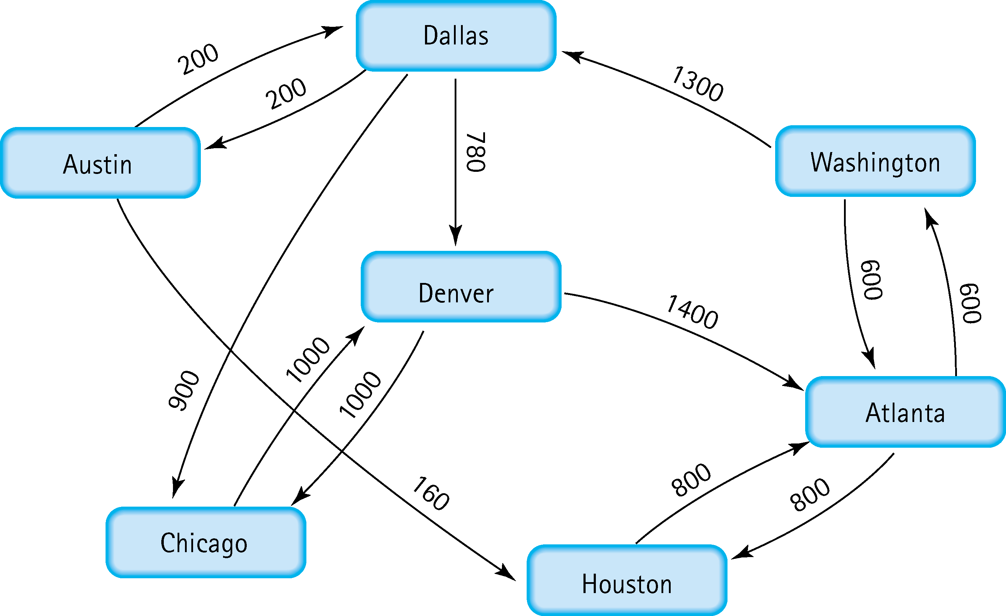
Find the shortest distance from Atlanta to every other city
Shortest path from Atlanta to Washington:
Direct path: Atlanta → Washington (600)
Shortest path from Atlanta to Houston:
Direct path: Atlanta → Houston (800)
Shortest path from Atlanta to Denver:
Through Dallas: Atlanta → Washington → Dallas → Denver (600 + 1300 + 780 = 2680)
Shortest path from Atlanta to Dallas:
Through Washington: Atlanta → Washington → Dallas (600 + 1300 = 1900)
Shortest path from Atlanta to Chicago:
Through Dallas: Atlanta → Washington → Dallas → Chicago (600 + 1300 + 900 = 2800)
Shortest path from Atlanta to Austin:
Through Dallas: Atlanta → Washington → Dallas → Austin (600 + 1300 + 200 = 2100)

Slide 5
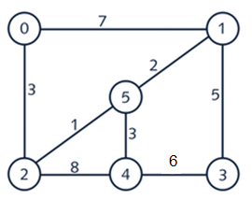


6. Find the minimal spanning tree using Prim’s algorithm. Use
0 as the source vertex . Show the steps.
T={(0, 2), (2, 5), (5, 1), (5, 4), (1, 3)}

Slide 6


7. Find the minimal spanning tree using Kruskal’s algorithm.
Show the weights in order and the steps.
(2, 5) with weight 1
(5, 1) with weight 2
(0, 2) with weight 3
(5, 4) with weight 3
(1, 3) with weight 5

Slide 7
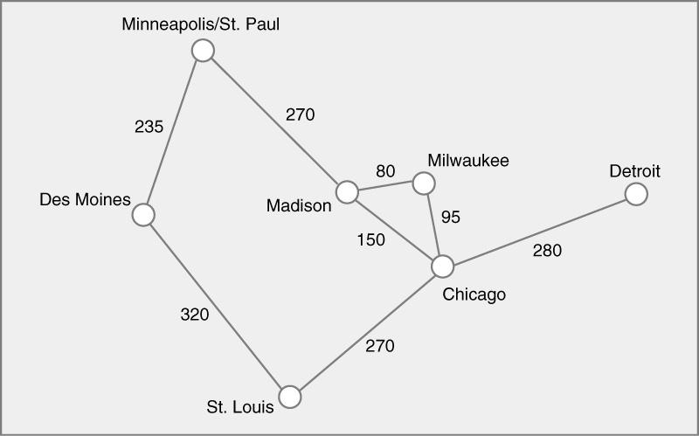




8. Find the minimal spanning tree using the algorithm you prefer. Use
Minneapolis/St. Paul as the source vertex

Slide 8
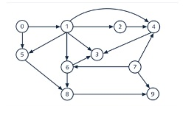
9. List the nodes of the graph in a breadth first topological ordering. Show the
steps using arrays predCount, topologicalOrder and a queue
Initial State: predCount: [0, 1, 1, 3, 3, 2, 2, 0, 2, 2]
queue: [0, 7]
topologicalOrder: []
1) predCount: [0, 0, 1, 3, 3, 1, 2, 0, 2, 2]
queue: [7, 1]
topologicalOrder: [0]
2) predCount: [0, 0, 1, 3, 2, 1, 1, 0, 2, 1]
queue: [1]
topologicalOrder: [0, 7]
3) predCount: [0, 0, 0, 2, 1, 0, 0, 0, 2, 1]
queue: [5, 6, 2]
topologicalOrder: [0, 7, 1]
4) predCount: [0, 0, 0, 2, 1, 0, 0, 0, 1, 1]
queue: [6, 2]
topologicalOrder: [0, 7, 1, 5]
5) predCount: [0, 0, 0, 1, 1, 0, 0, 0, 0, 1]
queue: [2, 8]
topologicalOrder: [0, 7, 1, 5, 6]
6) predCount: [0, 0, 0, 1, 0, 0, 0, 0, 0, 1]
queue: [8, 4]
topologicalOrder: [0, 7, 1, 5, 6, 2]
7) predCount: [0, 0, 0, 1, 0, 0, 0, 0, 0, 0]
queue: [4, 9]
topologicalOrder: [0, 7, 1, 5, 6, 2, 8]
8) predCount: [0, 0, 0, 0, 0, 0, 0, 0, 0, 0]
queue: [9, 3]
topologicalOrder: [0, 7, 1, 5, 6, 2, 8, 4]
9) predCount: [0, 0, 0, 0, 0, 0, 0, 0, 0, 0]
queue: [3]
topologicalOrder: [0, 7, 1, 5, 6, 2, 8, 4, 9]
10) predCount: [0, 0, 0, 0, 0, 0, 0, 0, 0, 0]
queue: []
topologicalOrder: [0, 7, 1, 5, 6, 2, 8, 4, 9, 3]

Slide 9
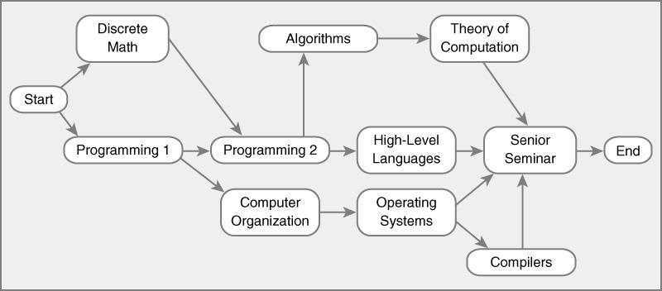
10. List the nodes of the graph in a breadth first topological ordering.
Breadth First Topological Ordering: Start, Discrete Math, Programming 1, Programming 2, Computer Organization, High-Level Languages, Algorithms, Operating System, Theory of Computation, Compilers, Senior Seminar, End

